Slide 1



Solving N-Queen’s Problem using Backtracking Algorithm Approach
PROJECT GUIDE
Dr. K. Sathya, B.Tech, M.Tech, Ph.D
Associative Professor
PROJECT MEMBER
Birundha.K-23ADR020
Brindha Ramesh-23ADR021
Dushyant-23ADR044

Slide 2
OBJECTIVE
The N-Queens problem is a classic combinatorial problem in computer science and mathematics.
It involves placing NN queens on an N×NN×N chessboard such that no two queens threaten each other.
Backtracking is an algorithmic technique for solving problems by exploring all possible solutions.

Slide 3
PROBLEM STATEMENT
The N-Queens problem is a classic combinatorial problem in computer science and mathematics. It involves placing N-queens on an N×N chessboard such that no two queens threaten each other.
No two queens share the same row.
No two queens share the same column.
No two queens share the same diagonal.
The goal is to find all valid arrangements or determine if a valid arrangement exists.

Slide 4
ALGORITHM USED
Backtracking Algorithm:
Backtracking is an algorithmic technique for solving problems by exploring all possible solutions and abandoning those that fail to meet the problem's constraints.
It is a refinement of brute force that systematically searches for a solution while pruning unnecessary branches of the search tree.

Slide 5
IMPLEMENTATION
def print_board(board):
"""Prints the chessboard."""
for row in board:
print(" ".join("Q" if col else "." for col in row))
print("\n")
def is_safe(board, row, col, n):
# Check column above
for i in range(row):
if board[i][col]:
return False
# Check upper left diagonal
i, j = row, col
while i >= 0 and j >= 0:
if board[i][j]:
return False
i -= 1
j -= 1
# Check upper right diagonal
i, j = row, col
while i >= 0 and j < n:
if board[i][j]:
return False
i -= 1
j += 1
return True
def solve_n_queens_util(board, row, n, solutions):
if row == n:
solutions.append([row[:] for row in board])
return
for col in range(n):
if is_safe(board, row, col, n):
board[row][col] = 1
solve_n_queens_util(board, row + 1, n, solutions)
# Backtrack: Remove the queen
board[row][col] = 0
def solve_n_queens(n):
board = [[0] * n for _ in range(n)]
solutions = []
solve_n_queens_util(board, 0, n, solutions)
# Print all solutions
for idx, solution in enumerate(solutions, start=1):
print(f"Solution {idx}:")
print_board(solution)
print(f"Total solutions for {n}-Queens: {len(solutions)}")
# Example Usage
n = int(input("Enter the value of N for the N-Queens problem: "))
solve_n_queens(n)

Slide 6
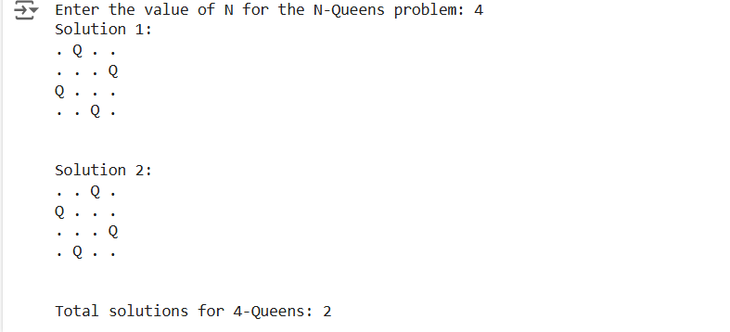
RESULT

Slide 7
CONCLUSION
Backtracking is a powerful algorithmic paradigm that systematically explores all possible solutions to a problem, abandoning paths that do not satisfy the constraints.
It is particularly effective for solving combinatorial and constraint satisfaction problems.
Applicable to a wide range of problems, such as N-Queens, Sudoku, and graph coloring.

Slide 8
THANK YOU

